Slide 1

Memory Game App
A simple and fun game to sharpen your mind
Farzaneh Ahmadi

Slide 2




Hello, I'm Farzaneh Ahmadi! 🌟
Physics
Quantum Computing
Computer Science
Web Developing

Slide 3

Hello, I'm Farzaneh Ahmadi! 🌟
Physics
Quantum Computing
Computer Science
Web Developing

Slide 4
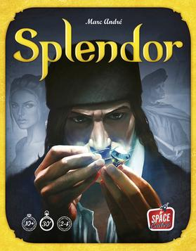
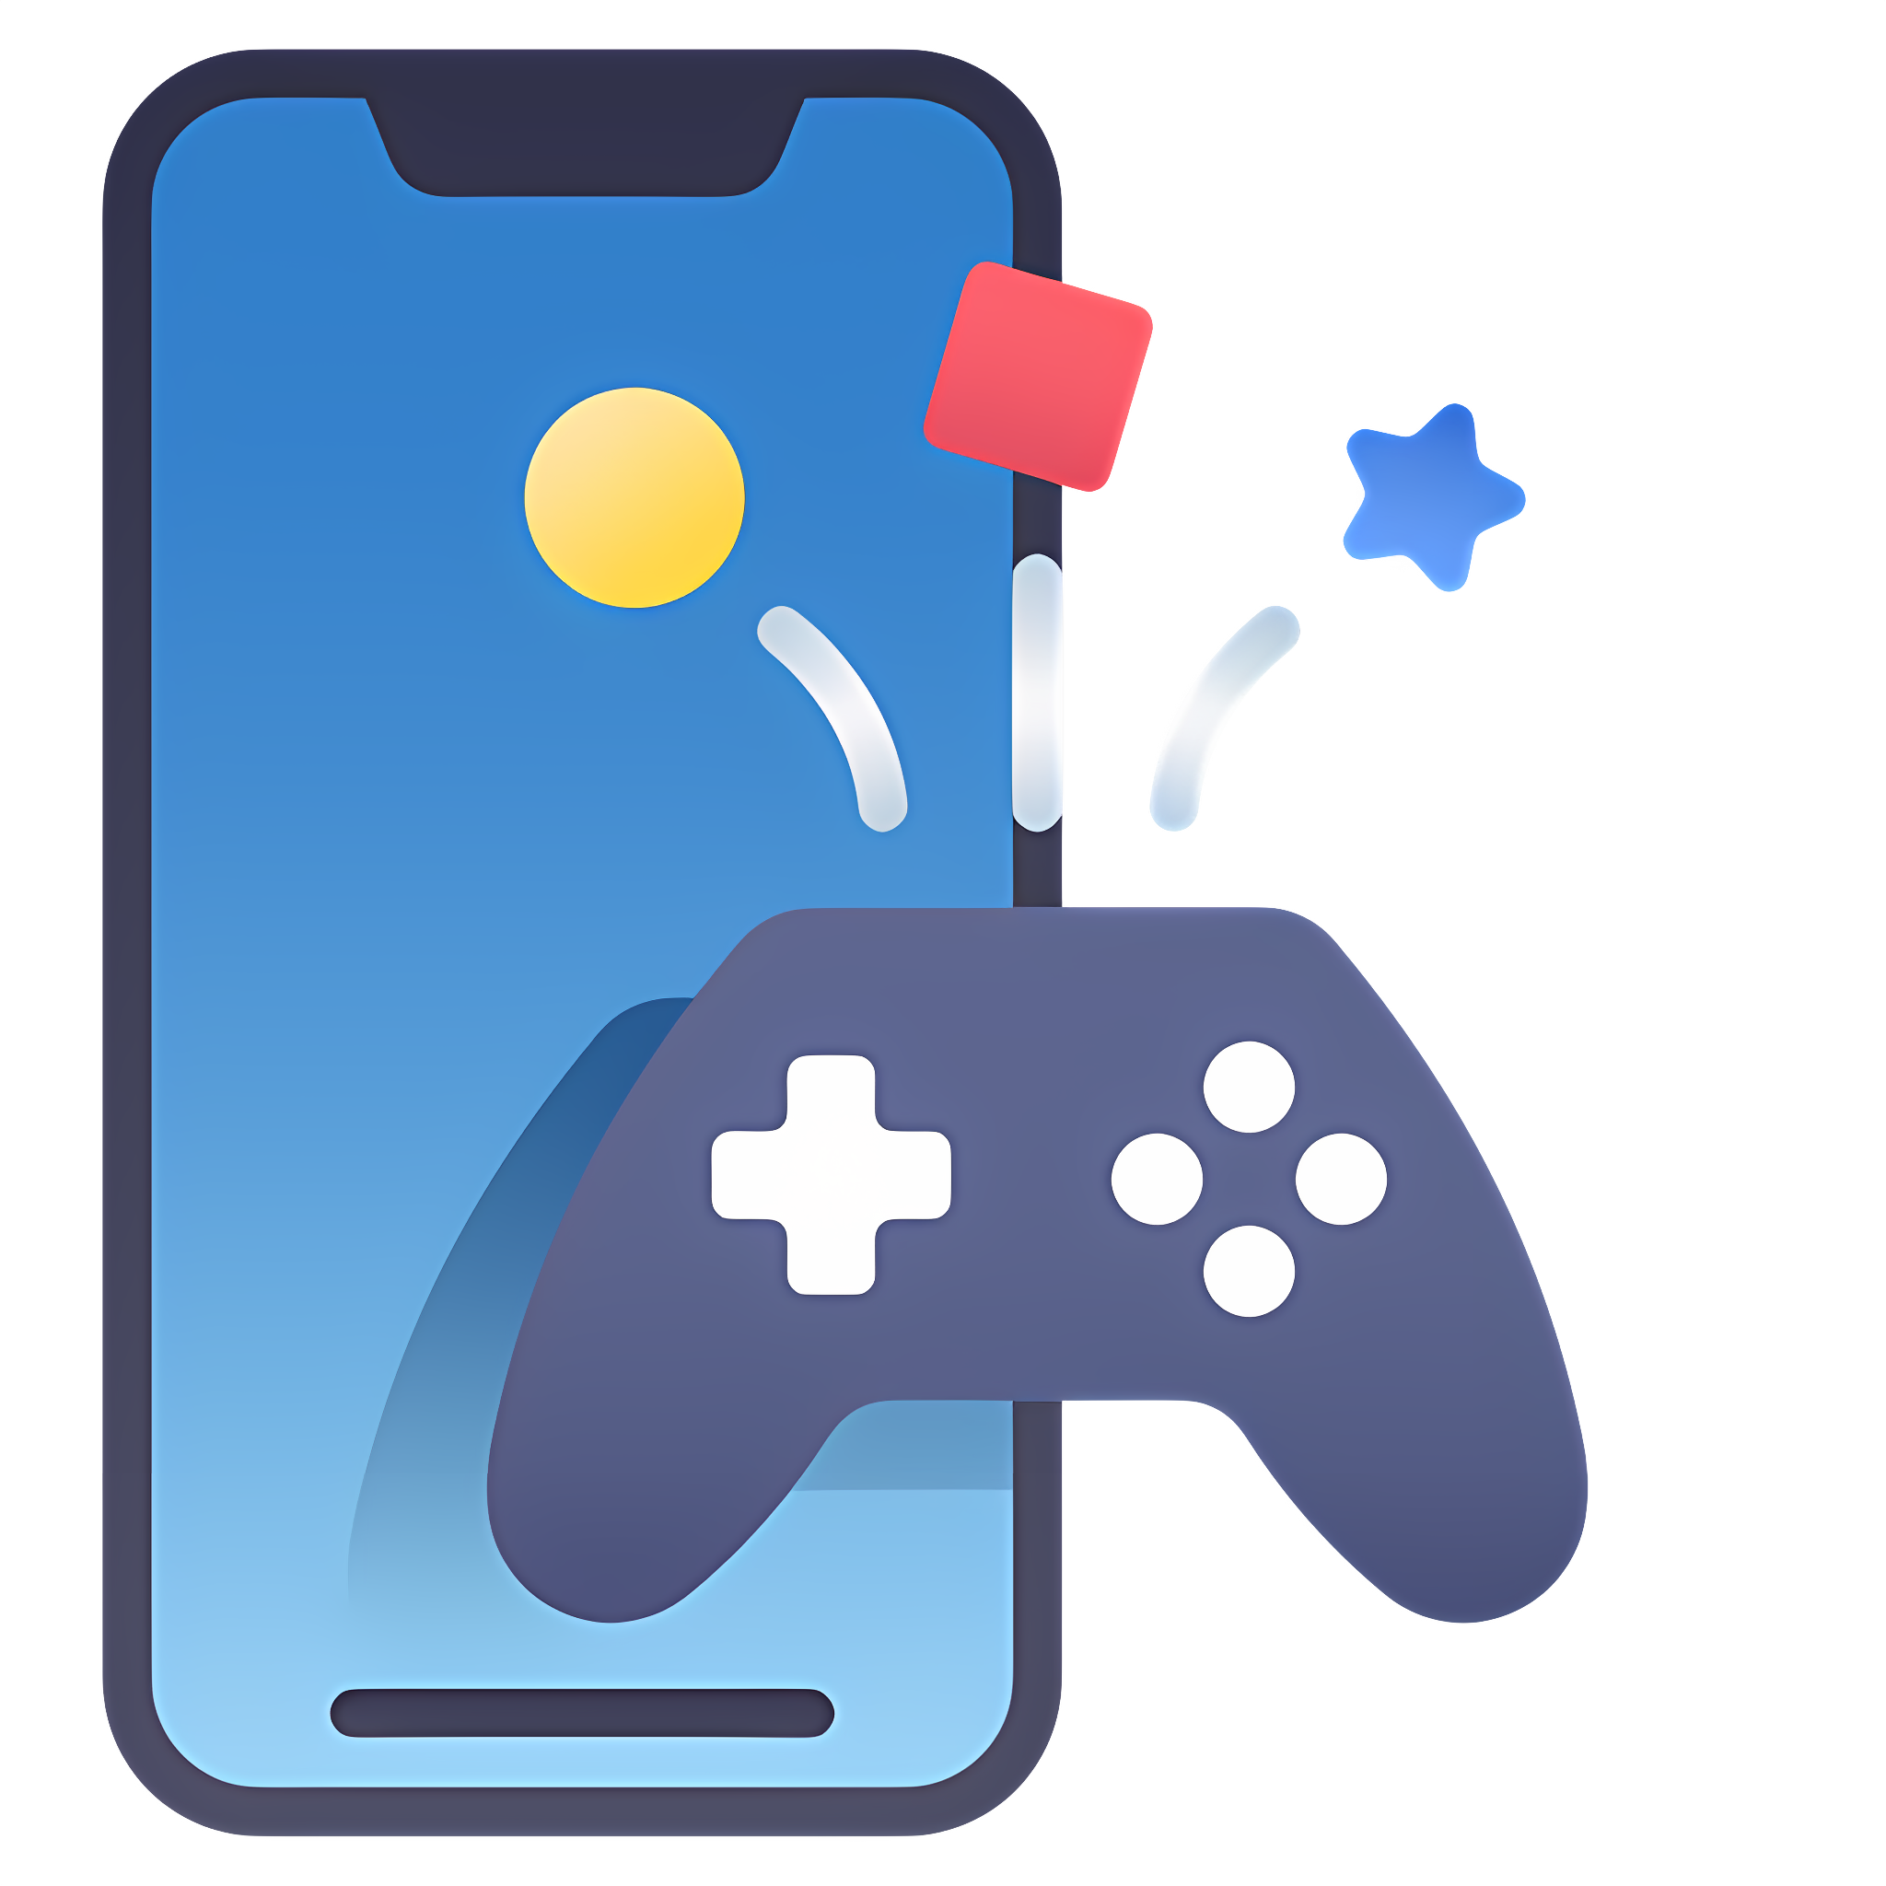
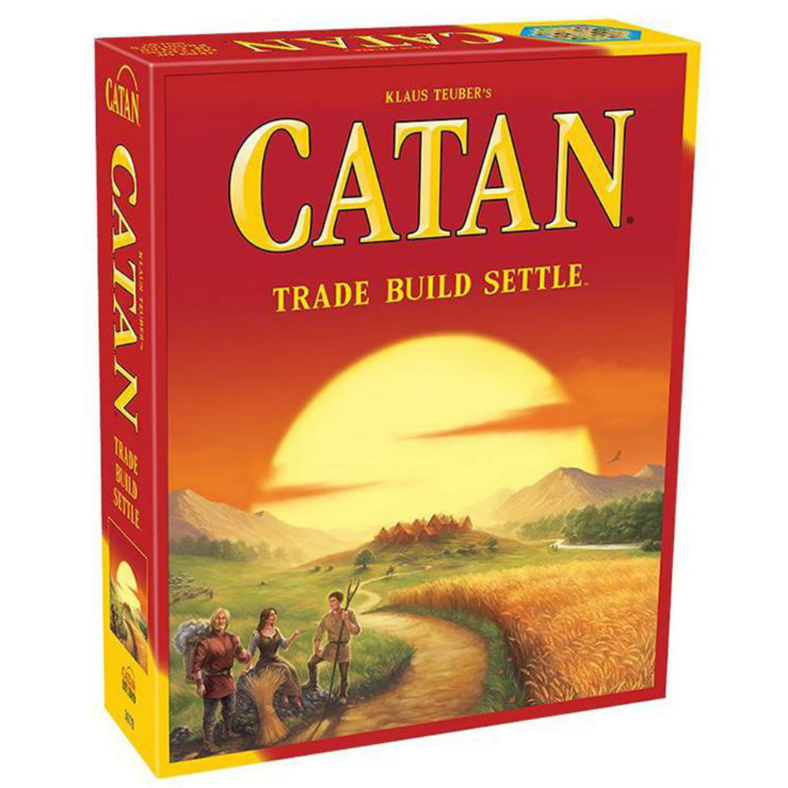

Why I Chose the Memory Game App?

Slide 5
Why I Chose the Memory Game App?
First Step to Game Design Fun for All Ages
Keeps Users Involved

Slide 6
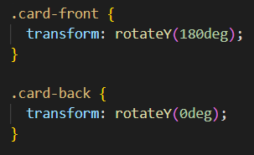
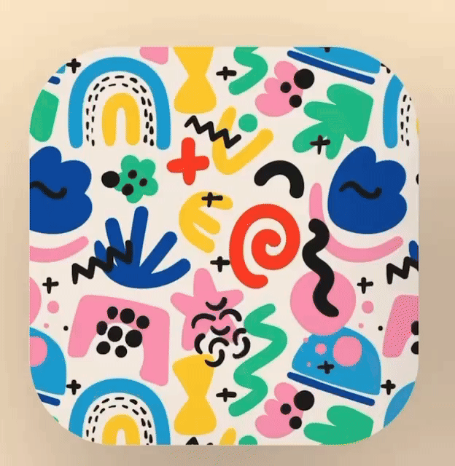
What Was Challenging?
CSS Card Flip Challenge

Slide 7
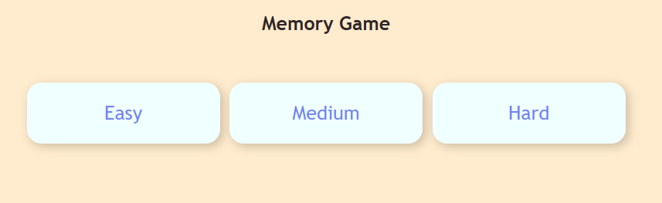
What Was Challenging?
It is also the coolest feature!
Difficulty levels

Slide 8
What Was Challenging?
It is also the coolest feature!
Fetching Data for Different Levels
Checking Completion Across Levels

Slide 9
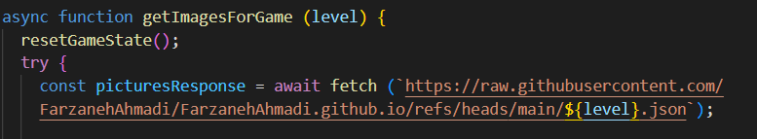
What Was Challenging?
It is also the coolest feature!
Fetching Data for Different Levels
Checking Completion Across Levels

Slide 10
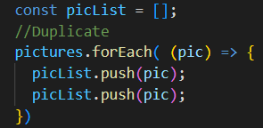
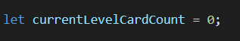
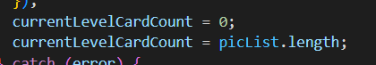
What Was Challenging?
Local variable
It is also the coolest feature!
Fetching Data for Different Levels
Checking Completion Across Levels
Created a new global variable
Assigned local variable to the global one

Slide 11
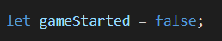
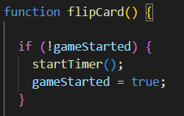
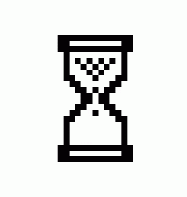
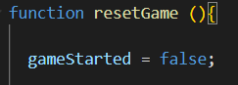
What Was Challenging?
Timer Not Resetting After Restart

Slide 12
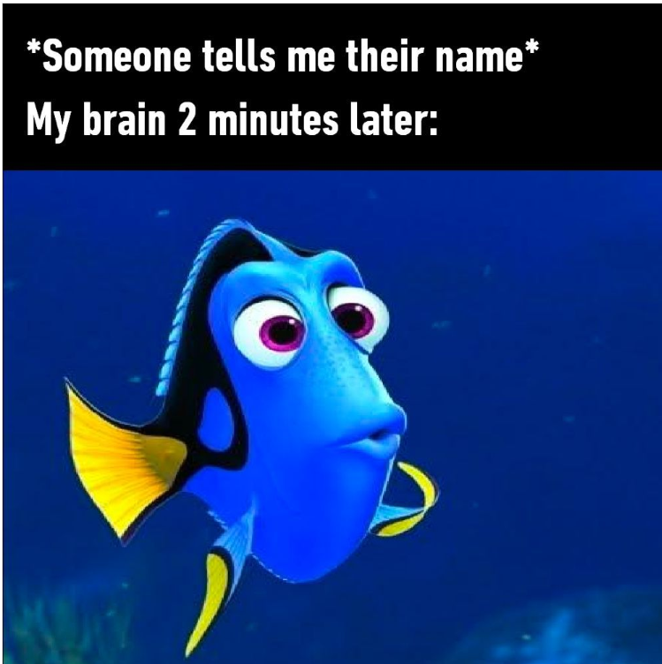
Coolest Features: Let’s See Them in Action!
Let’s try the game and see if you can beat Dory’s memory! 🤔💡
I flip 2 cards in the memory game…
My brain 2 seconds later: 'What cards?’
Live Demo Link

